Slide 1
Mini Intro to R
DigEx Lab

Slide 2
What is R?
Language and environment used for statistical computing and graphics
Based on the “S” Language
Open source => Free!
Runs on Windows, Linux, Mac OS
Huge user base
Lots of user packages

Slide 3
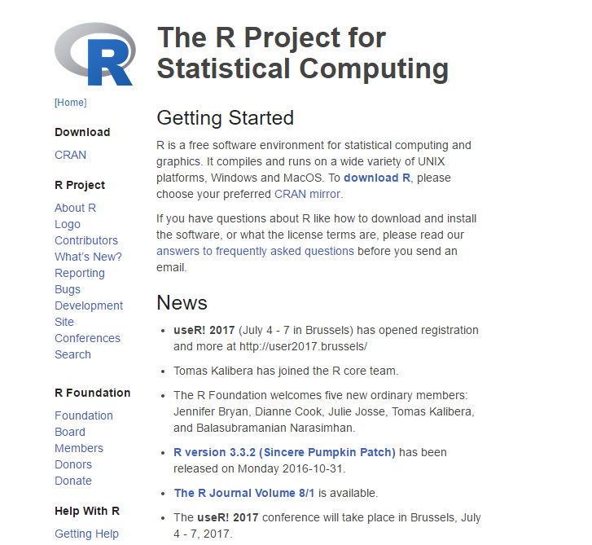
How do I get it?
Download base R
https://www.r-project.org
Download better R Interface
Rstudio
https://www.rstudio.com

Slide 4
R Studio IDE

Slide 5
Layout
Console
2+3
X <- 2+3
X
Environment
X
Plots/Packages/Help
Scripts/Datasets

Slide 6
Working with R
Case-sensitive interpreted language
Enter commands at prompt (>) or in batch
Statements consist of functions and assignments
Comments are preceded by #
semi-colon separates statements on a line
x <- c(4, 4, 5, 6, 7, 2, 9)
length(x) ; mean(x)
plot(x) # plot the vector

Slide 7
Important Points about R
Everything is done through functions
Functions manipulate objects
An object is anything that can be assigned to a variable name.
Includes constants, data structures, functions, and even graphs
All objects have a class - tells generic functions like print(), plot(), and summary() how to handle it.
Assignments are made with the <- operator

Slide 8
Example!
See example posted on slack.

Slide 9
Help!
Built-in options
help.start() -> General help
help(“foo”)/?foo -> Help on function foo
help.search(“foo”)/??foo -> search the help system for instances of the string foo
Google!!
QAC Tutors!
Quick-R (www.statmethods.net) and other useful websites!

